Slide 1
Making React Interact with useState and Events

Slide 2

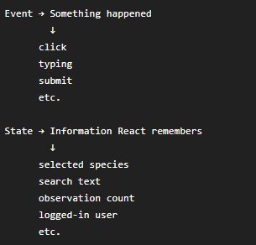
The problem with our current app
We displayed some buttons, for example:
Clicking it doesn’t do anything yet.
We need two new concepts:

Slide 3
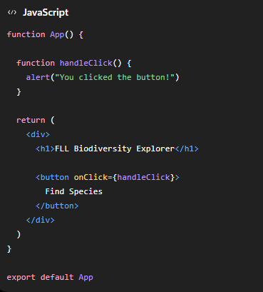

Our first onClick
Change App.jsx temporarily to:
Try clicking the button.
You should get a pop up:
This means:
When someone click this button, run the handleClick function

Slide 4

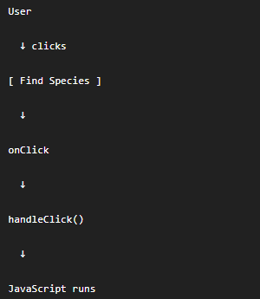
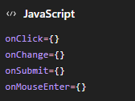
Understanding events
React connects the function to the button through
So the flow is:
React has many events:

Slide 5


Understanding state
After clicking the button “Select Species” , React needs to remember which species was selected. That’s called state. We use:
At the top of App.jsx, we have :
Now let’s set a button “selectMonarch” on the browser and display selected species under a header “Selected Species”. So we change function App() in App.jsx to:

Slide 6
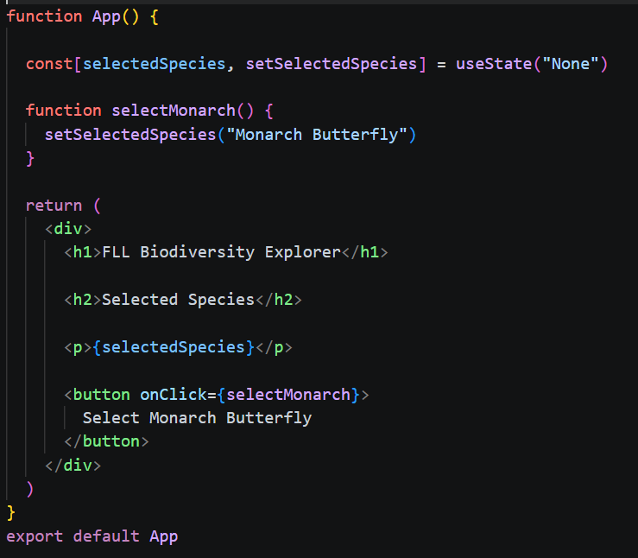


Understanding state
This means:
Create a state called selectedSpecies. Start it as “None” and make a function called setSelectedSpecies for changing it.
Here, the state selectedSpecies change to Monarch Butterfly
Try it. Initially it displays
Click the button.
It changes to:

Slide 7
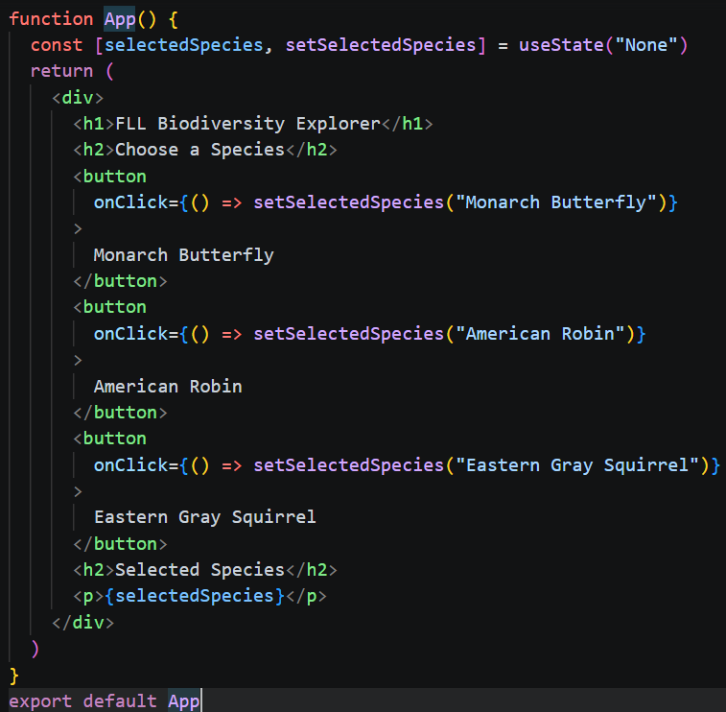

Add several species
Change function App() in App.jsx to:
This is an arrow function. It is a short version of
So it means:
  When this button is clicked, change selectedSpecies to “Monarch Butterfly”
Try clicking different buttons to see the changes.

Slide 8
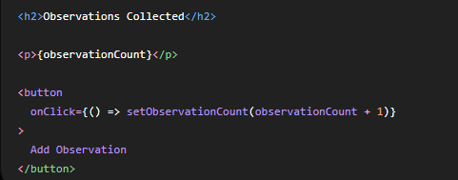

Let’s make a counter
In App.jsx function App( ), add
Then:
Now each click changes:

Slide 9
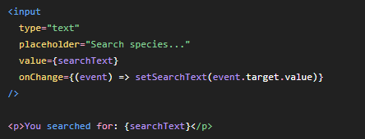

Let’s learn onChange
Buttons use onClick.
Text boxes commonly use onChange.
Add another state variable:
Then add:
Try typing “butterfly”
The page should immediately show:
What’s happing here:
When you type in the text box, React receives an event. Then React updates the state searchText

Slide 10

Add Reset button

Slide 11

Put everything together
See App_lesson3.jsx attached.
On the top, three state variables are created:
Do you know why these three pieces of information need state?
The most important concept of this lesson is
  Props are information passed into a component. State is information a component needs to remember and change.

